Slide 1
Arus Bolak-Balik
By:
Malik A. B.

Slide 2
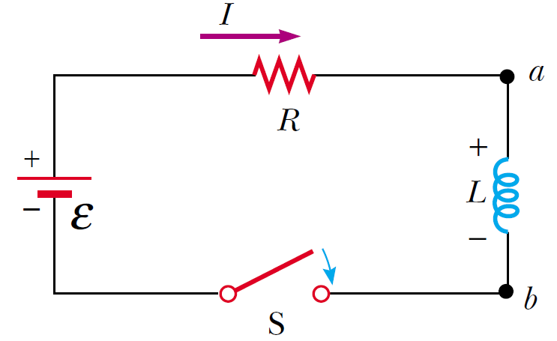

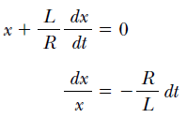


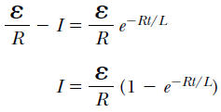
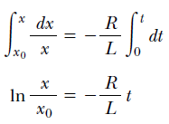

Rangkaian R-L dalam Arus Searah

Slide 3
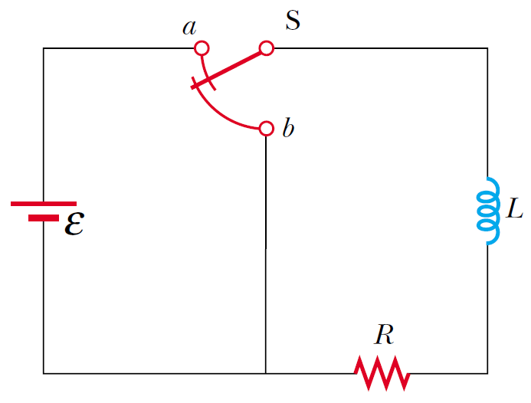


Rangkaian R-L dalam Arus Searah

Slide 4
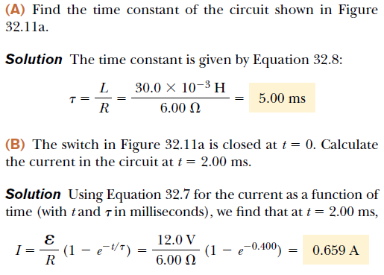
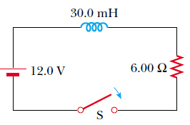
Contoh 1

Slide 5
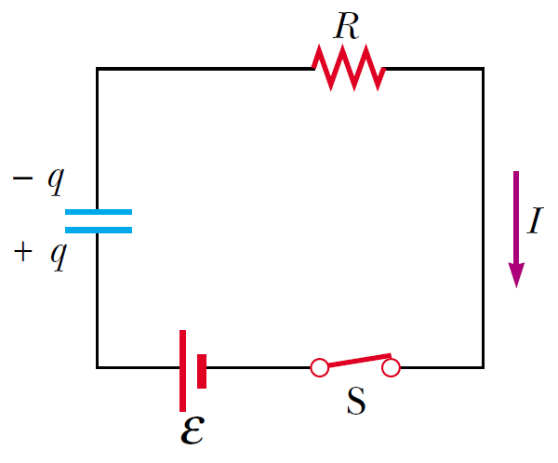


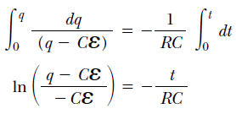




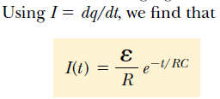

Rangkaian R-C dalam Arus Searah

Slide 6
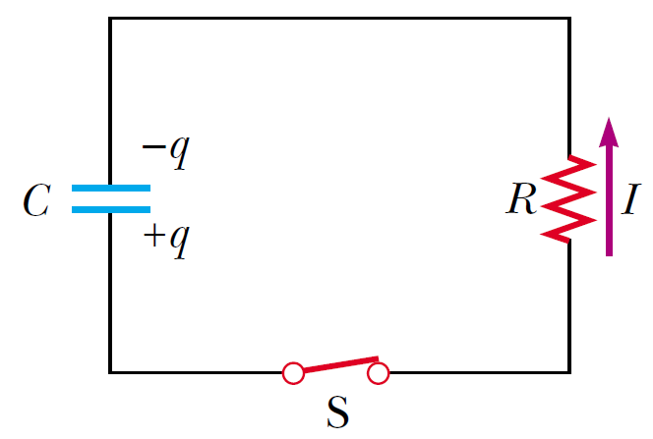

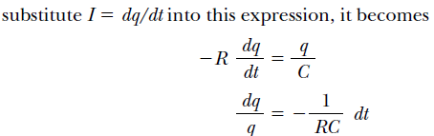
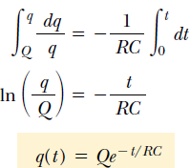

Discharging Capasitor dalam Arus Searah

Slide 7


Arus Bolak-Balik (Alternating current / AC)
An AC circuit consists of circuit elements and a power source that provides an alternating voltage Δv. This time-varying voltage is described by:
ΔVmax is the maximum output voltage of the AC source, or the voltage amplitude.
the angular frequency of the AC voltage is:

Slide 8

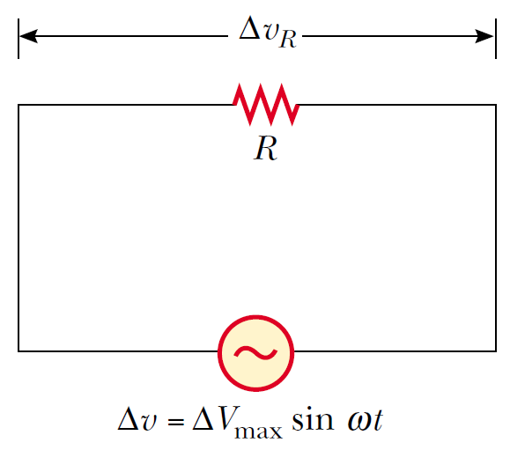



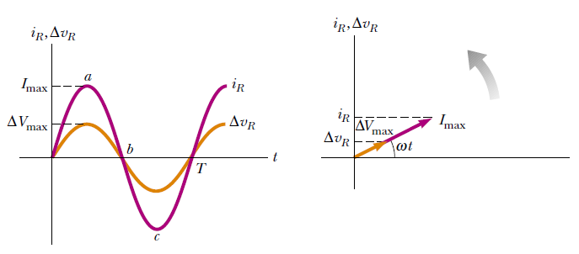

Resistor dalam Rangkaian AC

Slide 9
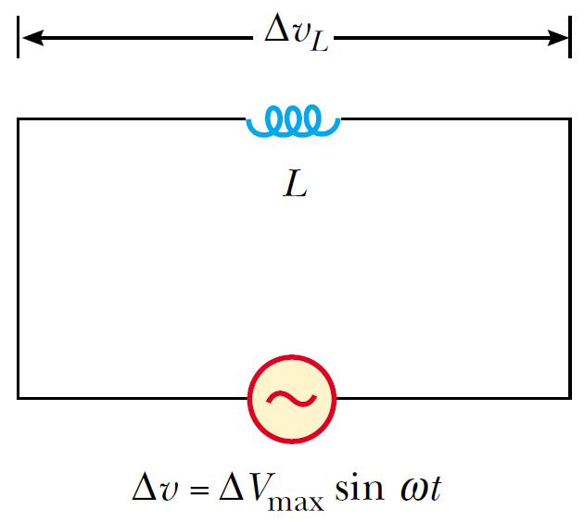





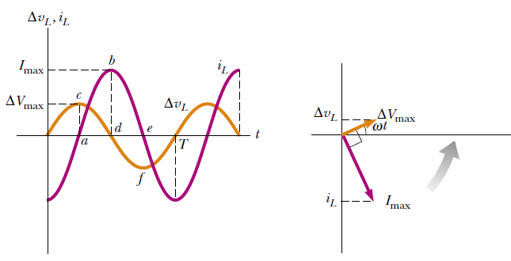


Induktor dalam Rangkaian AC
for a sinusoidal applied voltage, the current in an inductor always lags behind the voltage across the inductor by 90° (one-quarter cycle in time).

Slide 10




(Reaktansi Induktif; X_{L})
Induktor dalam Rangkaian AC

Slide 11
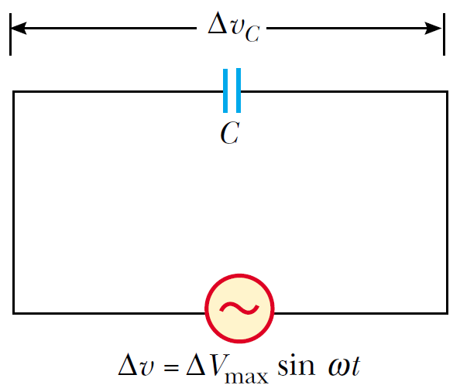






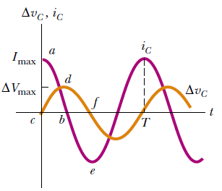
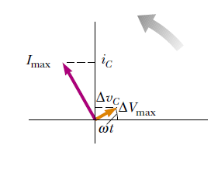

Kapasitor dalam Rangkaian AC
for a sinusoidally applied voltage, the current always leads the voltage across a capacitor by 90°.

Slide 12




(Reaktansi Kapasitif; X_{c})
Kapasitor dalam Rangkaian AC

Slide 13
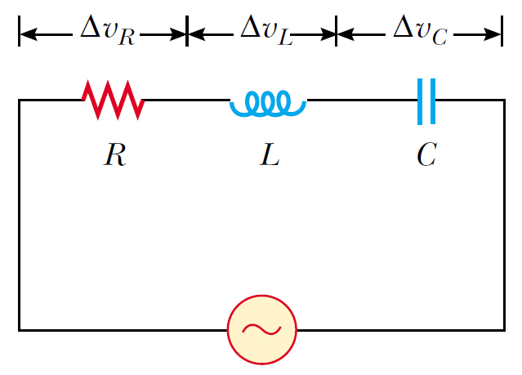
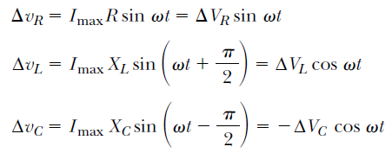
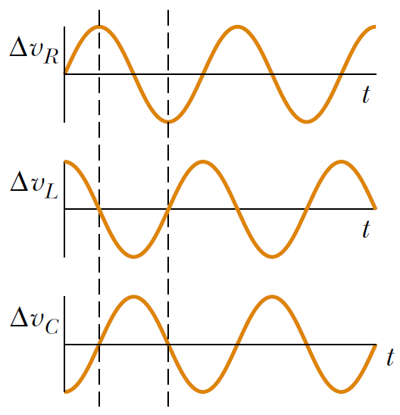

RCL Seri dalam Rangkaian AC

Slide 14
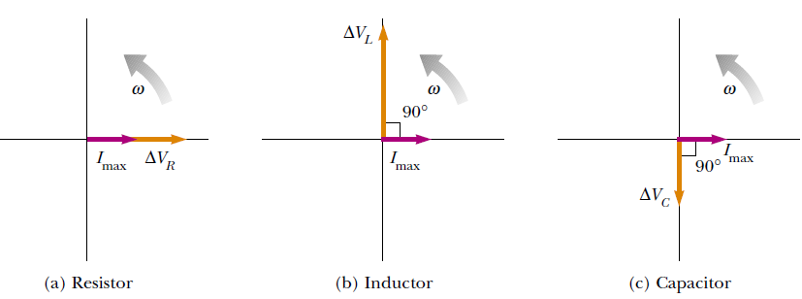
Diagram Fasor dari RCL Seri dalam Rangkaian AC

Slide 15
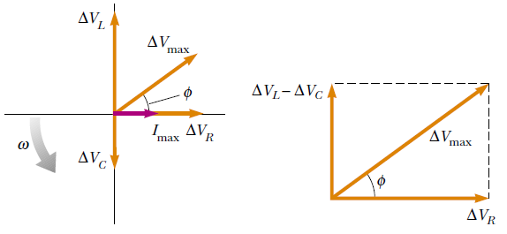
Diagram Fasor dari RCL Seri dalam Rangkaian AC

Slide 16

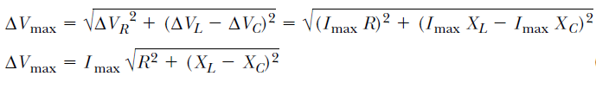

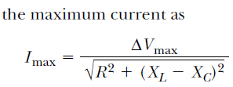





Diagram Fasor dari RCL Seri dalam Rangkaian AC

Slide 17
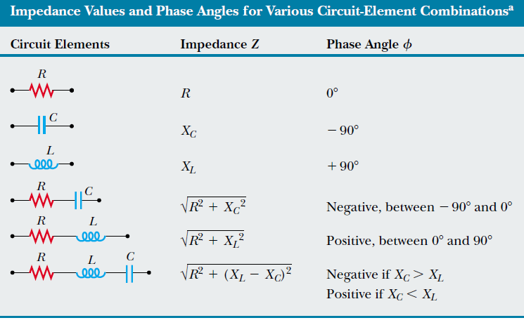

Slide 18



Resonansi dalam Rangkaian RCL Seri
A series RLC circuit is said to be in resonance when the current has its maximum value. In general, the rms current can be written:
Because the impedance depends on the frequency of the source, the current in the RLC circuit also depends on the frequency. The frequency ω₀ at which XL - XC = 0 is called the resonance frequency of the circuit. To find ω₀, we use the condition XL = XC, from which we obtain ω₀ L = 1/ ω₀ C, or

